Slide 1

PhpStorm Workshop
Maarten Balliauw Technical Evangelist
maarten.balliauw@jetbrains.com

Slide 2
Before we start
Make sure you have PhpStorm 7.1 installed
either full or free trial from http://jetbrains.com/phpstorm
Make sure you have a PHP runtime, webserver, MySQL, for example
XAMPP (Windows) - http://bit.ly/phpstorm-xampp
MAMP (Mac OS X) - http://bit.ly/phpstorm-mamp
Make sure you have git command line

Slide 3




Who am I?
Maarten Balliauw
Belgium (Antwerp)
Technical Evangelist, JetBrains
Focus on web
ASP.NET MVC, Windows Azure, PHP, API’s, ...
Big passion: cloud (Windows Azure)
http://blog.maartenballiauw.be
@maartenballiauw
Notes:
Maarten

Slide 4
How it all works
This course covers PhpStorm 7.1
But most is applicable to earlier versions
There will be some theory
And some practice
We will not cover every knob and bolt
I talk a lot, shut me up
Do ask questions!

Slide 5

Keyboard shortcuts
PhpStorm features multiple keymaps
Defaults per platform
Other IDEA-based IDE’s use a similar keymap
Cheat sheet: http://bit.ly/phpstorm-shortcuts

Slide 6
Agenda
Look at the IDE
Navigation
Editing
Inspections
Live Templates
Refactoring
Debugging
Todo Explorer
Unit Testing
Version Control
Databases
Deployment
Tools
Plugins

Slide 7
Look at the IDE

Slide 8
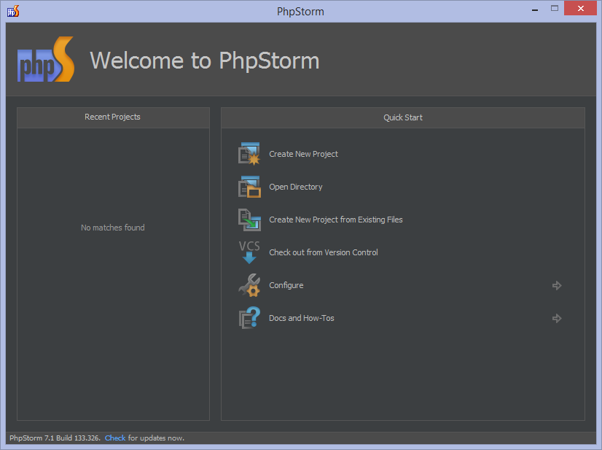
Newly installed IDE
Welcome screen
Create project
Open project
Checkout from version control
Configuration
Project? The basis for coding assistance, bulk refactoring, coding style consistency, etc.

Slide 9
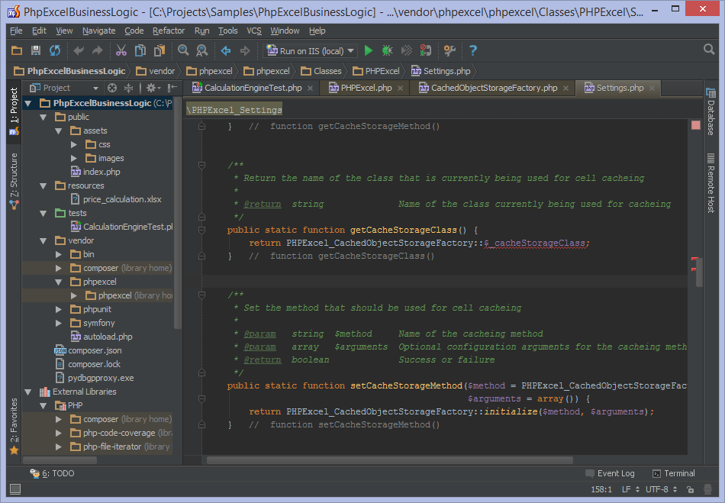
Opened project
Menus and toolbars
Execute various commands
Navigation bar
Navigate through project
Status bar
Information about IDE and project
Editor
Where coding happens
Tool windows
Numerous helpers (e.g. database, TODO, ...)

Slide 10
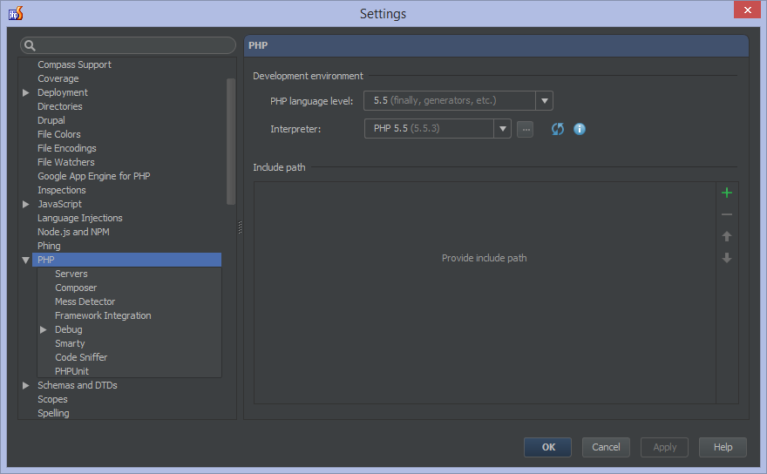
Configuring PHP
Under Project Settings | PHP, set PHP options.
Language level
Interpreter
Include paths
Debugging
...
Ctrl+Alt+S
Command+,

Slide 11
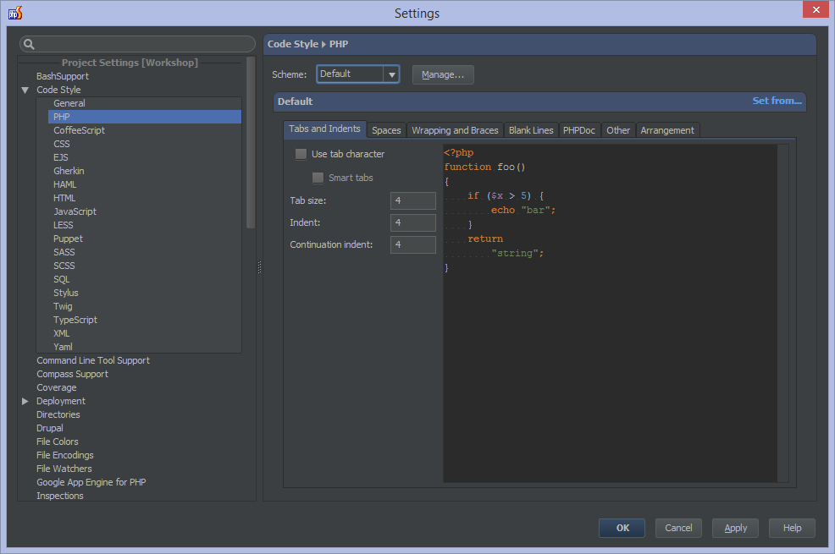
Configuring PhpStorm
Project settings
Specific for current project
IDE settings
Global for all projects
Ctrl+Alt+S
Command+,

Slide 12
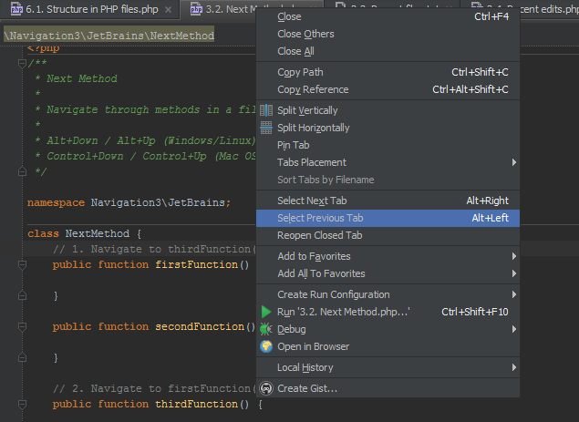
Tabs
Open a document each
Navigate between tabs
Pin tab
Split editor
Tabs can be favorited
Alt+Left / Right
Alt+Command+Left / Right

Slide 13
Let’s fetch the workshop materials
Start PhpStorm and if a project is opened, close it
Create a new project, name it “Workshop” and select the “Composer project” type
Find the “jetbrains/phpstorm-workshop” package and click OK
Alternatively, use “Checkout from Version Control”
Repository: https://github.com/jetbrains/phpstorm-workshop.git
Project / directory name: Workshop

Slide 14
Navigation

Slide 15
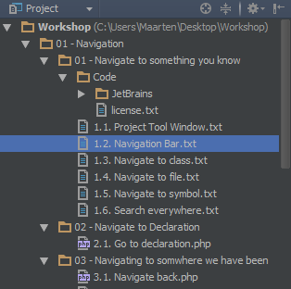
Project Tool Window
Shows all files in project.
Alt+1
Alt+1

Slide 16
Navigation Bar
Navigate through files in project.
Left/Right navigates path.
Up/Down opens other node in path.
Alt+Home
Alt+Home

Slide 17
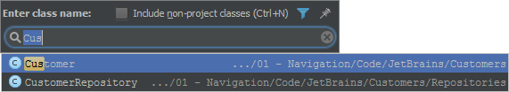
Navigate to Class
Navigates to a given class
can be in PHP or any other language supported by PhpStorm
use CamelHumps / wildcards
Ctrl+N
Command+O

Slide 18

Navigate to File
Navigates to a given file
any file type
use CamelHumps / wildcards
Ctrl+Shift+N
Shift+Command+O

Slide 19

Navigate to Symbol
Navigates to a given symbol
can be in PHP or any other language supported by PhpStorm
use CamelHumps / wildcards
Ctrl+Shift+Alt+N
Alt+Command+O

Slide 20
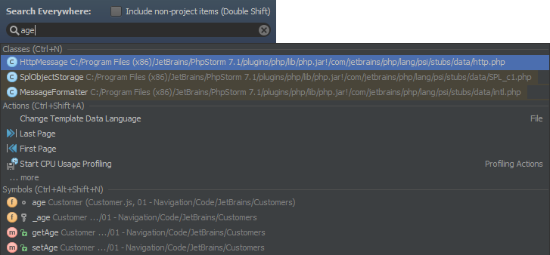
Search Everywhere
Search classes, file, symbols and menu actions all at once
use CamelHumps / wildcards
Double shift
Double shift

Slide 21

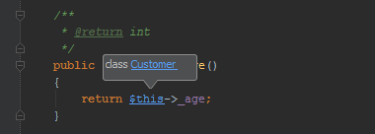
Navigate to Declaration
Ctrl-click for hyperlink
or use shortcut
Ctrl+B
Command+B

Slide 22

Navigate Back / Forward
Use the keyboard shortcut
Ctrl+Alt+Left / Right
Alt+Command+Left / Right

Slide 23

Next / Previous Method
Use the keyboard shortcut to navigate through methods in a file/class.
Navigates between tags in HTML. Also works in other file types.
Alt+Down / Alt+Up
Control+Down / Control+Up

Slide 24
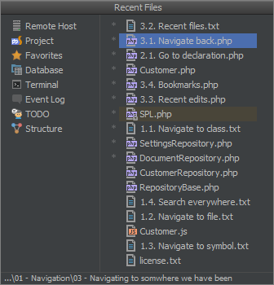
Recent Files
List of recent files
use CamelHumps / wildcards
Ctrl+E
Command+E

Slide 25
Navigate to Last Edit Location
Use the keyboard shortcut to navigate back to the last edit location.
Ctrl+Shift+Backspace
Shift+Command+Backspace

Slide 26
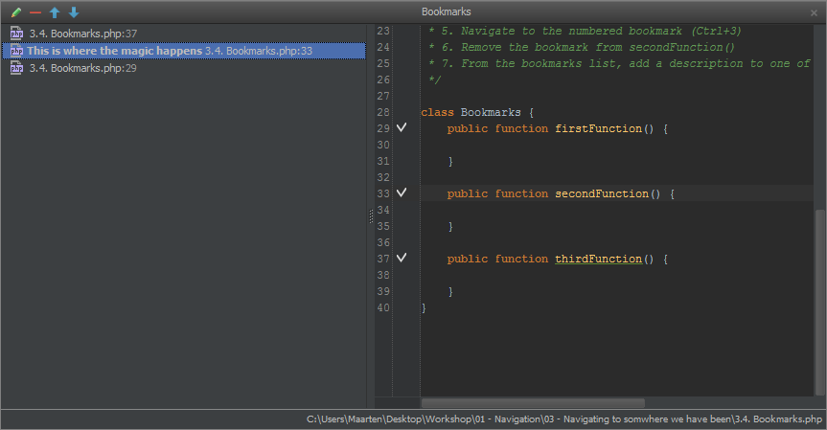
Bookmarks
Navigate between “bookmarked” locations.
F11 Toggle Bookmark
Ctrl+F11 Toggle Numbered Bookmark
Shift+F11 Show bookmarks
Ctrl+0..9 Navigate to numbered bookmark
F3 Toggle Bookmark
Alt+F3 Toggle Numbered Bookmark
Command+F3 Show bookmarks
Ctrl+0..9 Navigate to numbered bookmark

Slide 27

Go to Implementation
Navigates to the implementation of a given class.
Ctrl+Alt+B
Alt+Command+B

Slide 28
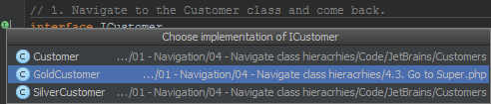
Go to Derived
Navigates to the implementation of a given interface or to a subclass.
Use the left gutter
Use the left gutter

Slide 29
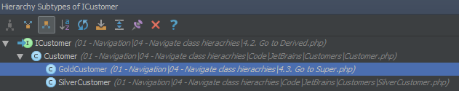
Go to Super class/method
Navigates to the super class or method.
Ctrl+U (Ctrl+H for hierarchy)
Command+U (Ctrl+H for hierarchy)

Slide 30
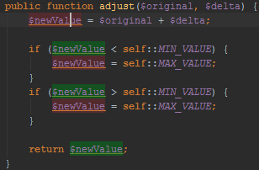
Highlight Usages in File
Highlights usages of a symbol in the current file. Different colors for read/write.
Esc to clear highlighting.
Ctrl+Shift+F7
Shift+Command+F7

Slide 31

Find Usages
Find usages of a symbol in the current project. Use tool window or popup.
Alt+F7 (Ctrl+Alt+F7 for popup)
Alt+F7 (Alt+Command+F7 for popup)

Slide 32
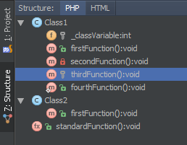
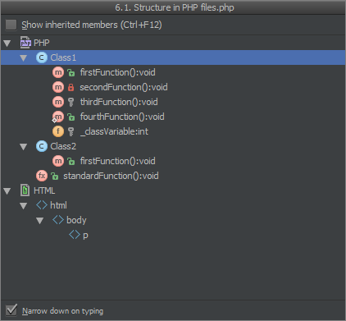
File Structure Tool Window
Displays outline of file: classes, functions (with icons displaying accessibility).
Also shows HTML, JavaScript, CSS, …
Alt+7 (Ctrl+F12 for popup)
Command+7 (Command+F12 for popup)

Slide 33
Editing

Slide 34
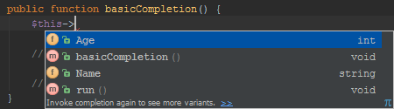
Basic Completion
Basic code completion for the name of any class, method or variable.
Hit Ctrl+Space twice for more variants
Also allows path completion
Ctrl+Space (Ctrl+Shift+Enter to complete statement)
Ctrl+Space (Shift+Command+Enter to complete statement)

Slide 35

Import Completion
Basic code completion when using classes or functions from other namespaces. Automatically adds import when selected.
Ctrl+Space (Ctrl+Shift+Enter to complete statement)
Ctrl+Space (Shift+Command+Enter to complete statement)

Slide 36
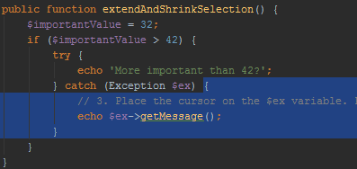
Selecting Code
Various ways of selecting code.
Ctrl+W to expand, Ctrl+Shift+W to shrink
Alt+Up / Down

Slide 37
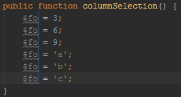
Column Selection
Toggle column selection. Allows editing multiple lines in one go.
Alt+Shift+Insert
Shift+Command+Insert

Slide 38
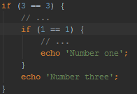
Moving Code
Move code or entire statement up/down.
Shift+Alt+Up / Down (or Shift+Ctrl+Up / Down for statement)
Shift+Alt+Up / Down (or Shift+Command+Up / Down for statement)

Slide 39
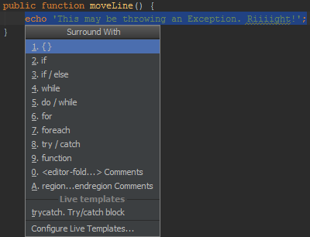
Surround With
Wraps selected text with new content, e.g. try/catch or if statement.
Ctrl+Alt+T and Alt+Enter
Alt+Command+T and Alt+Enter

Slide 40

Intentions
Let the IDE figure out possible actions from context and execute them.
Alt+Enter
Alt+Enter

Slide 41
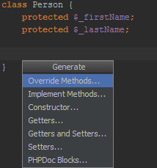
Generate Code
Generate code, e.g. class members, constructor, docblock comments, fields, ...
When used in navigation bar / project tool window, generates a new file.
Alt+Insert
Command+N

Slide 42
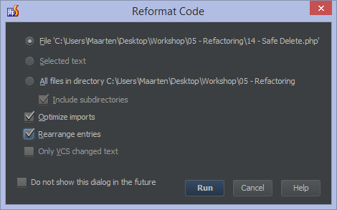
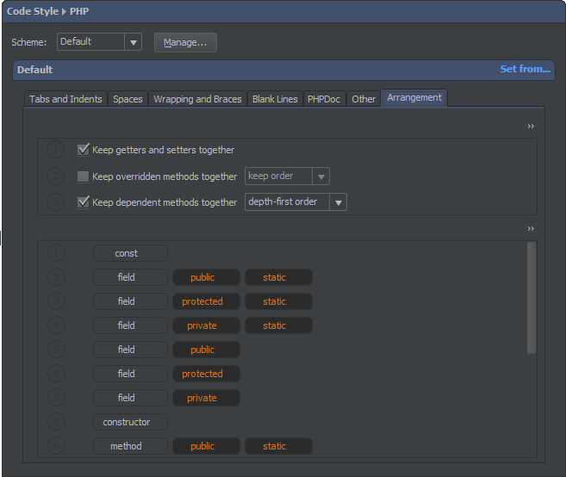
Rearrange/Reformat Code
Rearranges entries in code according to settings. Reformats all code according to code style.
Ctrl+Alt+L (reformat)
Alt+Command+L (reformat)

Slide 43
Inspections

Slide 44
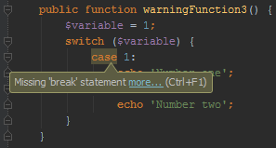
Highlights
In-editor highlighting of code issues.
Errors
Warnings
Suggestions
Hints
Dead Code
Can be suppressed.
Support for PHP Code Sniffer / PHP Mess Detector.

Slide 45

Quick Fixes
Highlights provide a Quick Fix action to help remove the warning.
Alt+Enter
Alt+Enter

Slide 46

Navigation
Navigate back and forth between code issues.
F2 / Shift+F2
F2 / Shift+F2

Slide 47
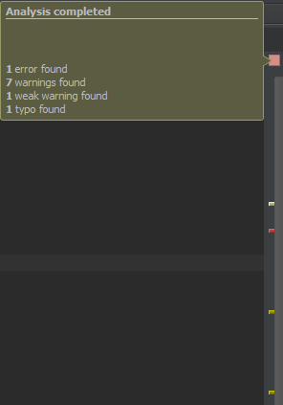
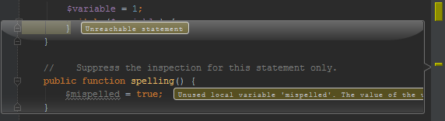
Gutter and Lens
Right gutter displays error information. Use Lens mode for preview.

Slide 48
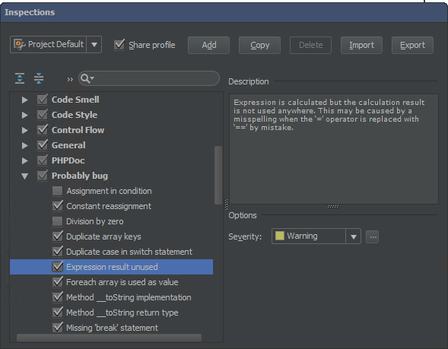
Settings
Enable/disable inspections, see examples and documentation.
Configure severity.
Ctrl+Alt+S
Command+,

Slide 49
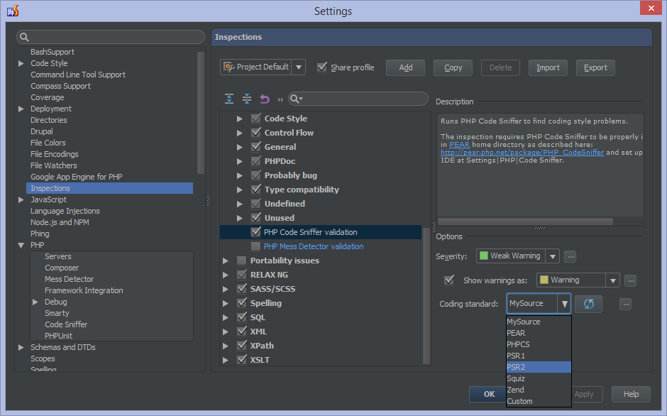
PHPMD / PHPCS
PHP Mess Detector and PHP Code Sniffer can be plugged in for inspections as well.
Ctrl+Alt+S
Command+,

Slide 50
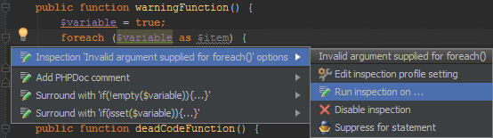
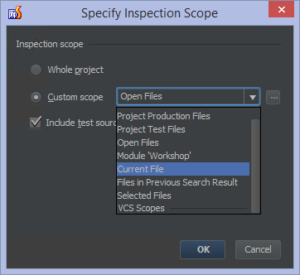
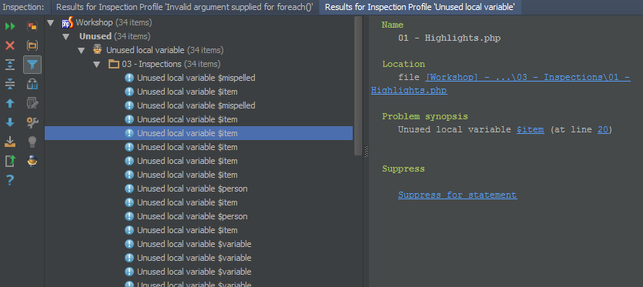
Find Issues
Quick fix menu allows finding all similar issues.
Alt+Enter
Alt+Enter

Slide 51
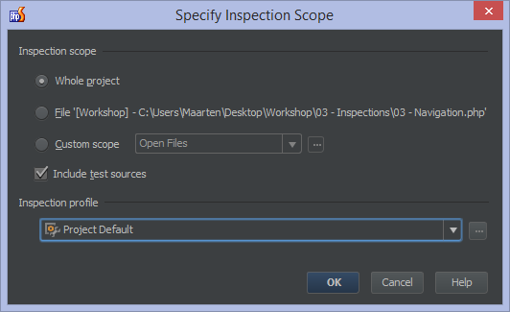
Run Inspections
Run an inspection profile and get results for the entire project (or scope).
Ctrl+Alt+Up / Down
Alt+Command+Up / Down

Slide 52
Live templates (snippets)

Slide 53

Code Expansion
Expand text shortcut using template.
Expands into code with variable “hotspots”
Hotspot can be linked to an expression, such as “current user”, “autocomplete”, …
Tab to move between hotspots.
Template can define end point for caret.
Tab
Tab

Slide 54
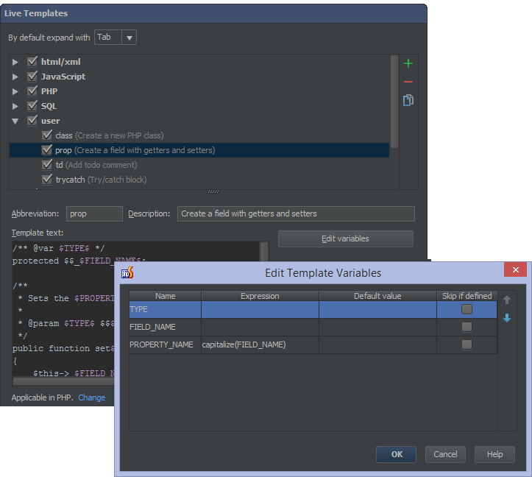
Creating Live Templates
Create your own live templates.
Use variables and expressions.
Can be created from settings or straight from within the editor.
$END$ variable denotes where caret should be after expansion.
Expressions: https://www.jetbrains.com/phpstorm/webhelp/edit-template-variables-dialog.html
Tab
Tab

Slide 55

Surround Templates
Surround code with a template.
Extra predefined variable:
$SELECTION$ is the currently selected text
Only considered a surround template when this macro is used.
Ctrl+Alt+T or Ctrl+Alt+J
Alt+Command+T or Alt+Command+J

Slide 56
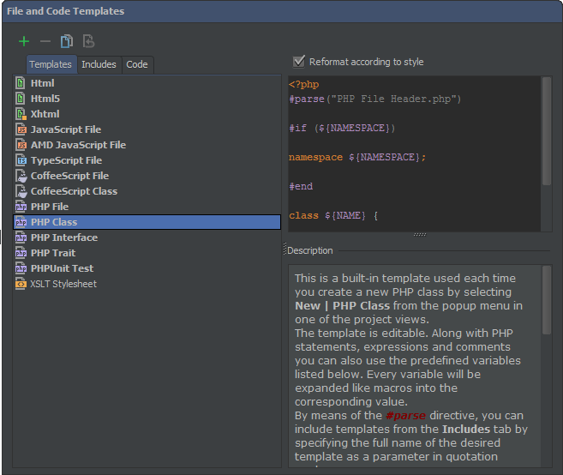
File Templates
Applied when creating a new file or generating code.
Can contain includes.
Customize code generation.
Variables: https://www.jetbrains.com/phpstorm/webhelp/file-template-variables.html
Ctrl+Alt+S
Command+,

Slide 57
Refactoring

Slide 58
“Refactoring is a controlled technique for improving the design of an existing code base.”
Martin Fowler http://martinfowler.com/books/refactoring.html

Slide 59
Refactoring in PhpStorm
The IDE will:
Perform the refactoring
Track down and correct the affected code references automatically
Warn about occurrences it can not update automatically
Available refactorings:
Change Signature
Copy/Clone
Extract Constant
Extract Field
Extract Interface
Extract Method
Extract Parameter
Extract Variable
Inline
Move Refactorings
Pull Members up
Push Members down
Rename Refactorings
Safe Delete

Slide 60
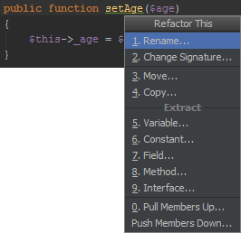
Refactor This
Refactor symbol or code fragment
In Project View, Structure Tool Window, Editor or UML Class Diagram.
Use menu item Refactor | Refactor This or keyboard shortcut.
Ctrl+Shift+Alt+T
Ctrl+T

Slide 61
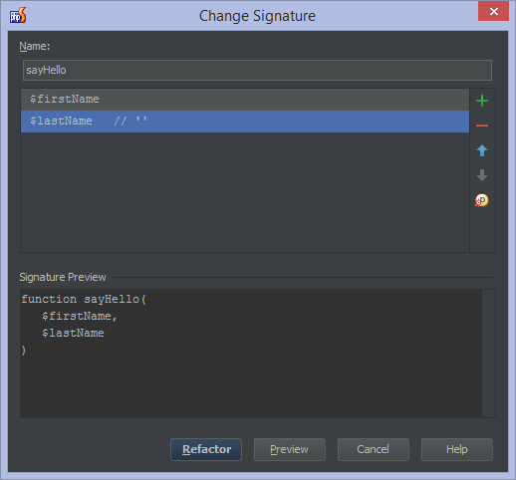
Change Signature
http://www.jetbrains.com/phpstorm/webhelp/change-signature.html
You can use this refactoring to:
Change the function name.
Add new parameters and remove the existing ones.
Assign default values to the parameters.
Reorder parameters.
Change parameter names.
Propagate new parameters through the function call hierarchy.
Ctrl+F6
Command+F6

Slide 62
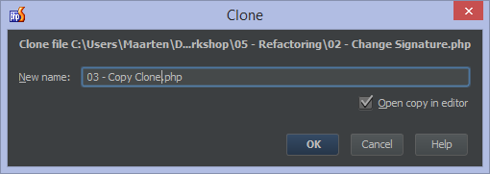
Copy/Clone
http://www.jetbrains.com/phpstorm/webhelp/copy-clone.html
Copy a class, file or directory to another directory or clone it within the same directory.
Using keyboard shortcut
Usign drag/drop with Ctrl key pressed)
F5 (copy), Shift+F5 (clone)
F5 (copy), Shift+F5 (clone)

Slide 63
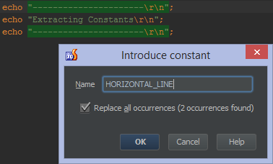
Extract Constant
http://www.jetbrains.com/phpstorm/webhelp/extract-constant.html
Extract a constant to make code cleaner and more maintainable.
Ctrl+Alt+C
Alt+Command+C

Slide 64
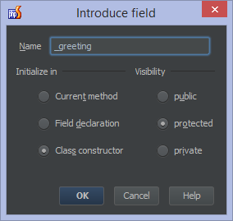
Extract Field
http://www.jetbrains.com/phpstorm/webhelp/extract-field.html
Extract an expression into a field.
Ctrl+Alt+F
Alt+Command+F

Slide 65
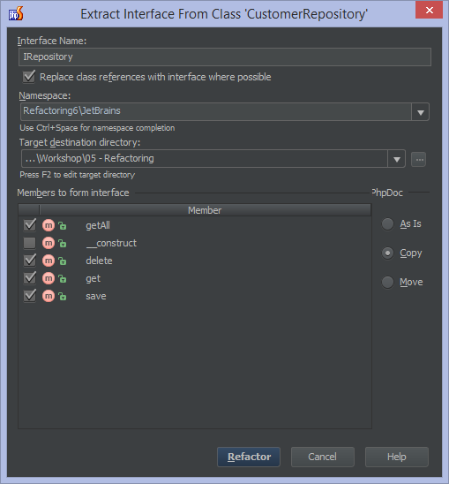
Extract Interface
http://www.jetbrains.com/phpstorm/webhelp/extract.html
Extract an interface from a class.
Specify a Name
Optionally chaneg namespace
Pick members to extract
Copy PHPDoc
Use the menu or Refactor This.

Slide 66
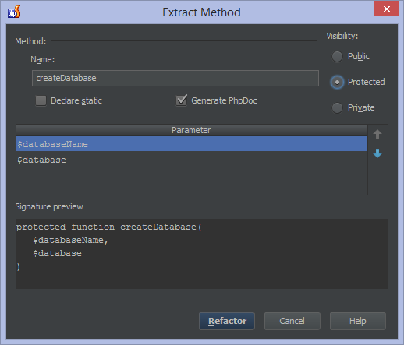
Extract Method
http://www.jetbrains.com/phpstorm/webhelp/extract-method.html
Extracts a block of code into a method, detecting variables.
Ctrl+Alt+M
Alt+Command+M

Slide 67
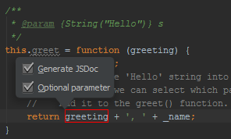
Extract Parameter
http://www.jetbrains.com/phpstorm/webhelp/change-signature.html
Adds a new parameter to a function declaration. Determines the default. Can generate JSDoc.
Ctrl+Alt+P
Alt+Command+P

Slide 68
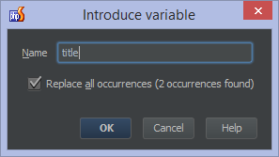
Extract Variable
http://www.jetbrains.com/phpstorm/webhelp/extract-variable.html
Puts the result of a selected expression into a variable. The original expression is replaced with the new variable.
Ctrl+Alt+V
Alt+Command+V

Slide 69
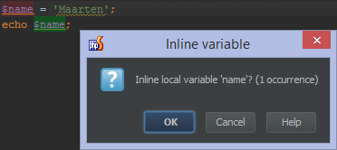
Inline
http://www.jetbrains.com/phpstorm/webhelp/inline.html
Replace redundant variables or functions with the full expression. It is the opposite of Extract Method.
Ctrl+Alt+N
Alt+Command+N

Slide 70
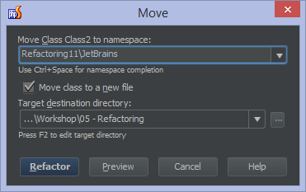
Move
http://www.jetbrains.com/phpstorm/webhelp/move-refactorings.html
Changes the location of a file, directory, class or static member.
Move File
Move Directory
Move Class
Move Static Member
F6
F6

Slide 71
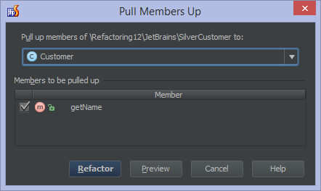
Pull Members Up / Push Members Down
http://www.jetbrains.com/phpstorm/webhelp/pull-members-up.html
Move members from subclass to superclass or from superclass to subclass.

Slide 72
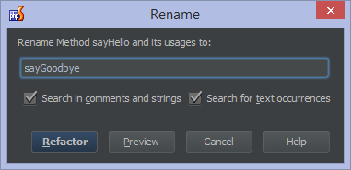
Rename
http://www.jetbrains.com/phpstorm/webhelp/rename-refactorings.html
Allow you to rename symbols, automatically correcting all references in the code.
Rename Class
Rename Method
Rename Field
Rename Function
Rename Variable
Rename Parameter
Rename CSS color value
Rename File
Rename Directory
Shift+F6
Shift+F6

Slide 73
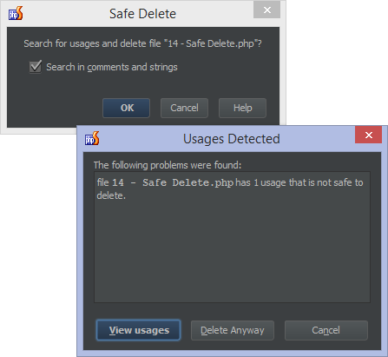
Safe Delete
http://www.jetbrains.com/phpstorm/webhelp/safe-delete.html
Safely remove code or symbols.
Alt+Delete
Command+Delete

Slide 74
Debugging

Slide 75
Debugging
“Finding and reducing bugs”
In an IDE typically stepping through code & inspecting values in memory
PhpStorm needs one of these configured:
Xdebug - http://confluence.jetbrains.com/display/PhpStorm/Xdebug+Installation+Guide
Zend Debugger - http://confluence.jetbrains.com/display/PhpStorm/Zend+Debugger+Installation+Guide
Most features supported by both debuggers

Slide 76
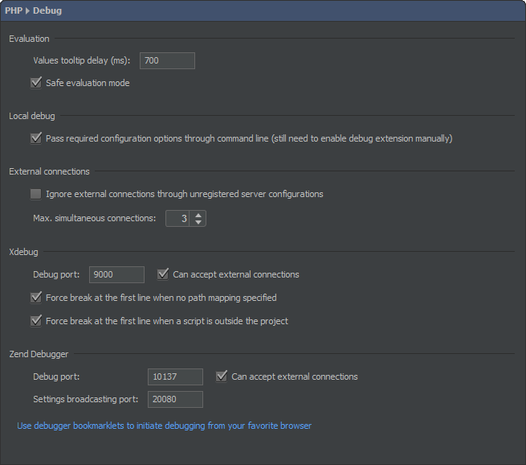
Settings
Debugger is configured through php.ini
Project Settings | PHP | Debug
How debug info is displayed in IDE
Xdebug / Zend Debugger port number
DBGp Proxy

Slide 77


Debugger Configuration Validation
PhpStorm analyzes configuration
Reports active debugger
When a server is configured, reports configuration issues

Slide 78

Breakpoints
Tell the interpreter to pause execution and inspect variables.
Ctrl+F8
Command+F8

Slide 79
Conditional Breakpoints
Tell the interpreter to pause execution and inspect variables, only when a specific condition is true.
Ctrl+Shift+F8
Shift+Command+F8

Slide 80

Breakpoints
See breakpoints that are specified and configure additional options.
Log a message to console
Remove the breakpoint after it has been hit
Disable breakpoint until another breakpoint has been hit
Ctrl+Shift+F8
Shift+Command+F8

Slide 81

Exception Breakpoints
Xdebug only!
Break when error, warning, notice or Exception occurs.
Ctrl+Shift+F8
Shift+Command+F8

Slide 82

Debug Tool Window
Available during a debug session.
Showing execution details, variables, watches.
Allows running code / modifying variable value.
Alt+5, Alt+F8 evaluate expression
Command+5, Alt+F8 evaluate expression

Slide 83

Debugging a Web Application
Use a Run Configuration
PHP HTTP Request – automate the request
PHP Web Application – start with debugging
Listen for incoming connections and use bookmarklets or plugin

Slide 84

DBGp Proxy
Debug on remote server.
Every developer can use different IDE key and debug independent from each other.
From http://matthardy.net/blog/configuring-phpstorm-xdebug-dbgp-proxy-settings-remote-debugging-multiple-users/

Slide 85

Profiling
Insight into # of calls, execution times per function, …

Slide 86
Todo explorer

Slide 87

Highlighting TODO
Listing tasks commented in code.
Work in every file type.
Default patterns:
// todo
// fixme
Alt+6
Command+6

Slide 88

Patterns
Customize todo patterns to recognize other keywords.
Ctrl+Alt+S
Command+,

Slide 89

Filtering
Filter tasks in the tool window based on pattern.
Alt+6
Command+6

Slide 90
Unit Testing

Slide 91


Writing PHPUnit tests
Create new file, select PHPUnit test.
Specify unit test details.
Alt+Insert or Ctrl+Shift+T (Go to Test)
Command+N or Command+Shift+T (Go to Test)

Slide 92

Running PHPUnit tests
Run Unit Tests using PHPUnit. Note that the PHPUnit framework can be acquired through PEAR or Composer.
Can be run local or on remote server (see http://www.jetbrains.com/phpstorm/webhelp/run-debug-configuration-phpunit-on-server.html)

Slide 93

Test-Driven Development (TDD)
Writing tests first, outlining expected results, after which the method under test gets implemented.
Alt+Enter
Alt+Enter

Slide 94


Code Coverage
See which statements have been tested and which statements have not.
Use the “Run tests with Coverage” action.
See https://www.jetbrains.com/phpstorm/webhelp/coverage.html

Slide 95


JavaScript Unit Testing
May require a plugin to be installed, e.g. Karma
Using Karma or JSTestDriver.
Installing Karma through NPM https://www.jetbrains.com/phpstorm/webhelp/preparing-to-use-karma-test-runner.html
Installing JSTestDriver https://www.jetbrains.com/phpstorm/webhelp/preparing-to-use-jstestdriver-test-runner.html
Support for
JSTestDriver Assertion framework
Jasmine
QUnit
Mocha

Slide 96
Version Control

Slide 97

Version Control
Keep a log of all changes
Synchronize copies across computers and developers
Go back in time
Who did what when why?
Compare versions
Rollback versions
Notes:
Have you ever...
Made a change to code, realized it was a mistake and wanted to go back?
Lost code or had a backup that was too old?
Had to maintain multiple versions of a product?
Wanted to know who did a change, when and why?
Wanted to see the difference between two (or more) versions of your code?
Wanted to prove that a particular change broke or fixed some piece of code?
Wanted to submit a change (patch) to someone else's code?
Wanted to see how much work is being done (where/when/who)?
Wanted to experiment with a new feature without interfering with working code?
Wanted to work on code with multiple persons in a structured way?

Slide 98
Concepts
Repository (local / remote)
Checking out / cloning
Fetch copy from repository
Commit
Submit changes to repository
Revision / changeset
What changed? When? Who? Why?
Stored in order
Conflicts
Diff
Branching / merging

Slide 99
Flavours
Centralized Version Control
Decentralized Version Control
Central repository = entire history
Devs work on a version and sync
Devs have copy of entire history
Work on a version and sync with any

Slide 100

Products all use different terms…
Checkout / Clone / Export
Commit / Check In
Push / Submit
Revert / Roll back
History / Log
Annotate / Blame
Compare / Diff
…

Slide 101
But they are similar in nature!
Unified VCS functionality in the IDE
CVS
Git
Subversion
Mercurial
Perforce
TFS (via plugin)
(others through plugins)
IDE enriched with specific functionality (e.g. push/pull)

Slide 102

Enabling VCS integration
Telling the IDE that the project is under a VCS system.
Use the VCS menu.

Slide 103

VCS operations
Perform operations on the version control system such as adding files, deleting files, committing changes and so on.
Alt+Backquote (Alt+`)
Ctrl+V

Slide 104

Committing Changes
Persisting the current changeset as a logical operation in the VCS, with a comment, author, ...
Ctrl+K
Command+K

Slide 105

Viewing History
View all information related to previous commits.
Alt+9
Command+9

Slide 106

Viewing Diff
Show changes made to a particular file.
Ctrl+D
Command+D

Slide 107

Git/Mercurial: Push/Pull
Persist local copy of VCS repository to remote copy.

Slide 108

Changelists
Work on multiple logical changes at the same time.
Name changelist.
Can be committed / shelved.
Alt+9
Command+9

Slide 109

Local history
Undo on steroids. Display changes made between commits, revert local changes, ...

Slide 110

Resources
Webinar recording
https://www.youtube.com/watch?v=OvgoBMVPyFc
Web help
http://www.jetbrains.com/phpstorm/webhelp /version-control-with-phpstorm-2.html

Slide 111
Databases

Slide 112

Connecting to a database (server)
Connecting to MySQL, DB2, Derby, SQL Server, Oracle, PostgreSQL, Sybase, H2, sqlite, Google, ...
Specify connection details
Download JDBC driver
Select schema / tables to work with

Slide 113

Database Console
SQL console with autocompletion, inspections, error highlighting, autocompletion on joins, ...
Ctrl+Shift+F10
Shift+Command+F10

Slide 114

Table Editor
Edit records in a table: insert, update, delete, ...
F4
F4

Slide 115


Create New Table
Create a new table in the database. Specify column options, default values, primary key, ...
Alt+Insert
Command+N

Slide 116

Database tools in PHP
Strings can be identified as a query, will provide autocompletion, highlighting, ability to go to query editor, run query right from PHP file, …
Ctrl+Space / Ctrl+Shift+Space
Ctrl+Space / Ctrl+Shift+Space

Slide 117
Deployment

Slide 118

Remote Hosts
Copy files and folders back and forth between local project and server.
Can be FTP, FTPS, SFTP, Local or Mounted Folder or In Place.

Slide 119

Integration with VCS
Upload files to server when committing to source control.
Useful for development servers.
For production servers better to use continuous integration server.

Slide 120
Tools

Slide 121

REST Client
The built-in REST client allows testing web API's. Build requests, inspect responses.

Slide 122

Composer
Work with Composer dependency manager in the IDE.
Initialize Composer
Search and install Composer dependencies
Create new project using Composer project type.
Command Line Tools (see further)

Slide 123

Command Line Tools
Invoke command line tools shipped with frameworks and libraries.
Composer, Zend Framework, Symfony, Symfony Console-based, Drush or roll your own
Autocompletion support
Not meant to be a full console/terminal!
Ctrl+Shift+X
Shift+Command+X

Slide 124

Vagrant
Vagrant is a tool which helps us create reproducible development environments by scripting a virtual machine.
See http://blog.jetbrains.com/phpstorm/2013/08/vagrant-support-in-phpstorm/

Slide 125

Remote SSH Terminal
Connect to a remote SSH server. Provides a full SSH terminal in the IDE.

Slide 126

Remote SSH External Tools
Invoke remote commands over SSH without having to manually log in to the remote server.
Add them to PhpStorm menus for easy access.
Assign keyboard shortcut.
http://confluence.jetbrains.com/display/PhpStorm/Using+the+PhpStorm+built-in+SSH+terminal+and+remote+SSH+external+tools#UsingthePhpStormbuilt-inSSHterminalandremoteSSHexternaltools-WorkingwithremoteSSHexternaltools

Slide 127

Local Terminal
Provide a local terminal. Works on any platform supported by PhpStorm.
Ctrl+Space / Ctrl+Shift+Space
Ctrl+Space / Ctrl+Shift+Space

Slide 128
Plugins

Slide 129

PhpStorm = IntelliJ IDEA – JAVA + plugins
Base IDE enriched with plugins
Some plugins are for paid IDE only
Which is cool: WebStorm features can be installed in PhpStorm
A lot of free / open source plugins at http://plugins.jetbrains.com/?phpStorm
Install from IDE Settings | Plugins

Slide 130
Some interesting JetBrains plugins
LiveEdit - view changes live in browser and vice-versa
NodeJS - install Node.js packages (NPM) in a similar way to Composer
IdeaVim - adds VIM capabilities to the IDE
Handlebars/Mustache and EJS - plugins for working with client-side template engines
JSTestDriver and Karma - run JavaScript unit tests
Puppet Support - provides editor support for puppet, very conventient with Vagrant
...

Slide 131
Some interesting open source plugins
'Copy' on steroids - copy rich text from the editor
Markdown - provides Markdown editor support and syntax highlighting
BashSupport - support bash files in editor
AngularJS - support for AngularJS
Symfony, Yii, CakeStorm, ... - framework-specific plugins
CodeGlance - the editor scrollbar on steroids
EditorConfig - support for EditorConfig settings
Get Gist - fetch a Gist from GitHub and insert it into code
...

Slide 132
There is much more...

Slide 133
What we did not cover...
Be sure to try these afterwards!
File Watchers – monitor a file and run command when it changes (e.g. LESS to CSS)
Google App Engine – work with GAE development environment and deploy
Drupal Support – project support, code style, hooks, ...
Live Edit – view changes live in browser and vice-versa
Issue Tracker – open and browse issues from YouTrack, JIRA, GitHub, ...
HTML, CSS, JS tools
Framework Integration – integrate with Symfony, Yii, ...
GitHub support – pull requests, gists, ...

Slide 134
Resources

Slide 135
Resources
Keyboard reference - http://bit.ly/phpstorm-shortcuts
Blog - http://blog.jetbrains.com/phpstorm/
Web Help - http://www.jetbrains.com/phpstorm/webhelp/
Tutorials - http://confluence.jetbrains.com/display/PhpStorm/Tutorials
Courseware (videos) – http://bit.ly/phpstorm-videos
Webinars - http://blog.jetbrains.com/phpstorm/tag/webinar/
Twitter - https://twitter.com/phpstorm

